Slide 1
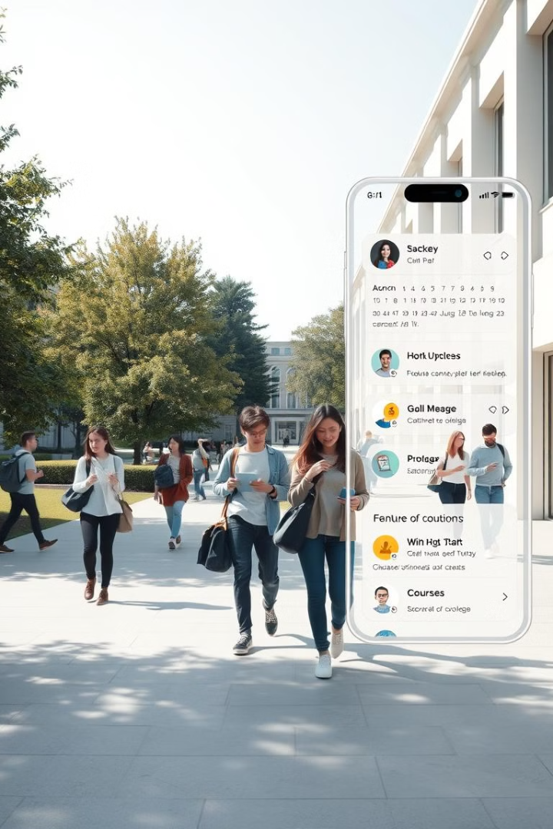
Eventify: Streamlining College Event Management
Eventify is a user-friendly, centralized platform designed to simplify event management at colleges and universities.
AT
by Anchal Tyagi, Aakriti Sharma,
Akshat Gautam, Anuj Singh

Slide 2
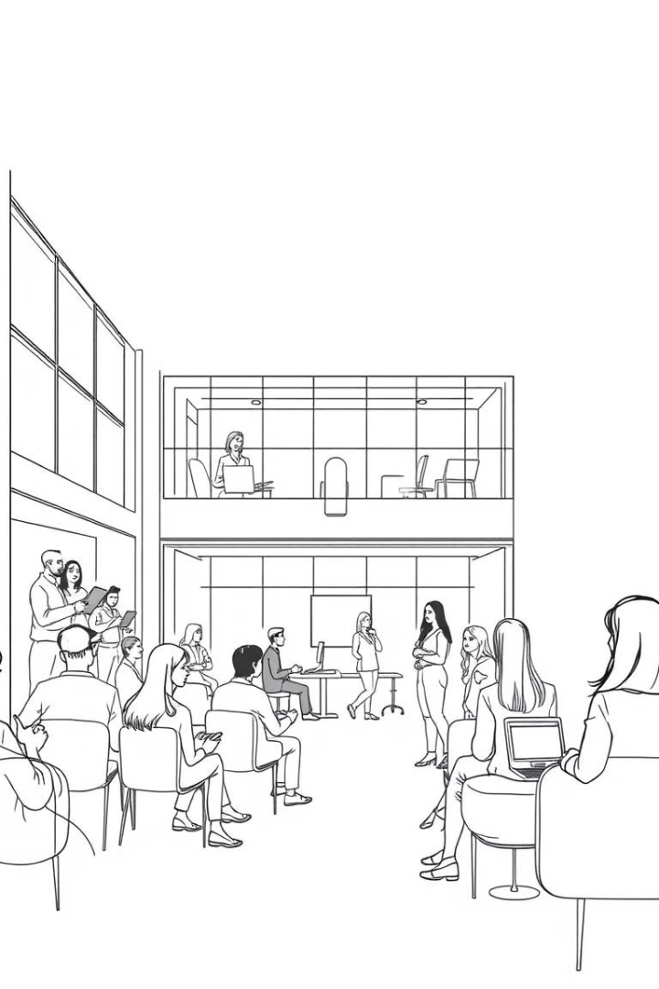
Project Abstract
Eventify aims to revolutionize campus event organization by providing a comprehensive platform for managing events from start to finish.
1
Centralized Hub
2
Enhanced Collaboration
A single platform for creating, promoting, and managing all campus events.
Real-time communication, event planning, and collaboration tools for students, faculty, and organizers.
3
Improved Efficiency
Automated tasks, streamlined workflows, and integrated communication channels for smoother event execution.

Slide 3
Project Goals and Objectives
Eventify's primary goals are to increase event visibility, boost participation, and foster a more engaging campus community.
Increased Event Visibility
Boosted Participation
Engaging Campus Community
Centralized platform promotes awareness of all campus events.
Streamlined registration, communication, and attendance tracking encourage greater participation.
Enhanced communication tools and collaborative features promote a vibrant and connected campus community.
Improved discoverability of events
Enhanced event promotion capabilities
Simplified event registration process
Real-time communication channels
Personalized event recommendations
Event feedback and discussion forums

Slide 4
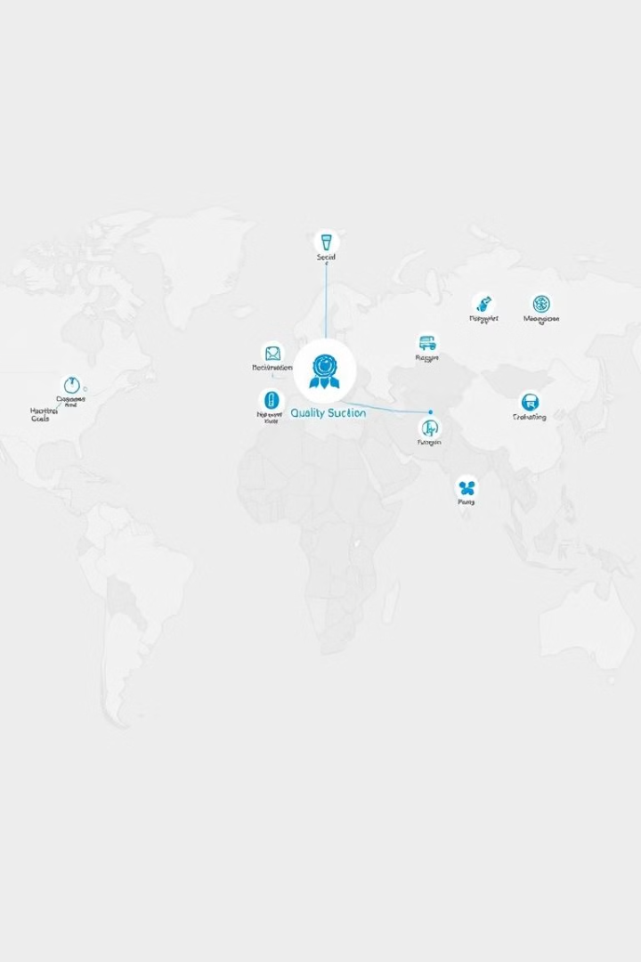
Alignment with UN Sustainable Development Goals (SDGs)
Eventify aligns with several UN Sustainable Development Goals, particularly those related to education, social inclusion, and community engagement.
SDG 4
Quality Education
Provides a platform for promoting workshops, seminars, and other educational events.
SDG 11
Sustainable Cities and Communities
Enhances community engagement and fosters a more vibrant and inclusive campus environment.
SDG 16
Peace, Justice and Strong Institutions
Promotes collaboration and communication among students, faculty, and organizers.

Slide 5
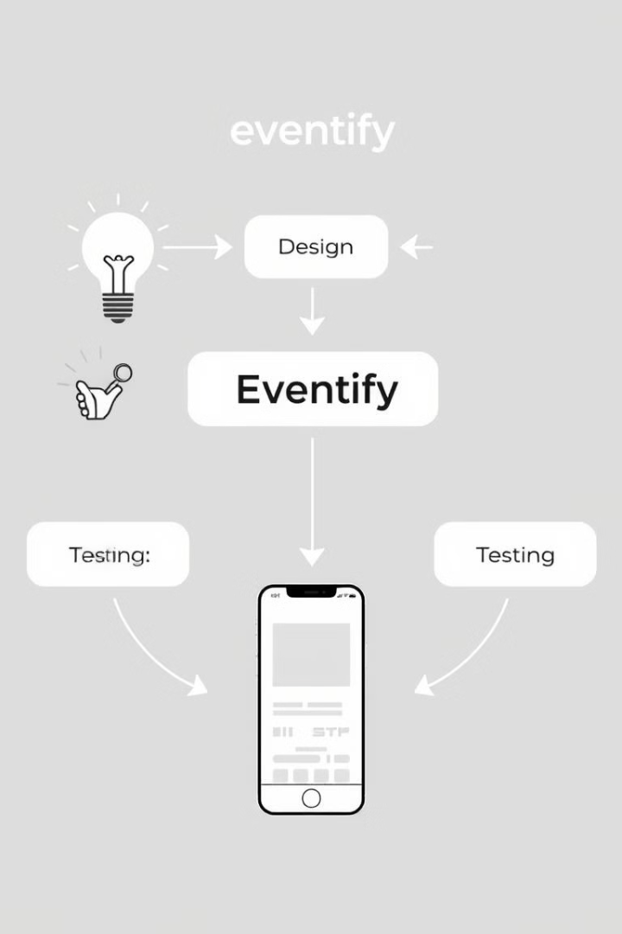
Methodology and Approach
Eventify's development involves a user-centered approach, focusing on collaborative design and iterative testing.
1
User Research and Analysis
In-depth understanding of the needs and pain points of students, faculty, and event organizers.
2
Design and Development
Iterative design process involving user feedback and testing, ensuring a user-friendly and intuitive platform.
3
Pilot Implementation and Feedback
Pilot launch at a select college or university to gather feedback and refine the platform.
4
Full-Scale Launch
Deployment of the fully functional Eventify platform across multiple colleges and universities.

Slide 6




Expected Outcomes and Impact
Eventify is expected to significantly impact the campus event landscape by increasing visibility, participation, and overall engagement.
Increased Event Visibility
Boosted Participation
Enhanced Community Engagement
Prominent display of events and improved discoverability for students.
Higher attendance rates and active engagement in campus events.
A more connected and vibrant campus community, fostered through collaboration and communication.

Slide 7
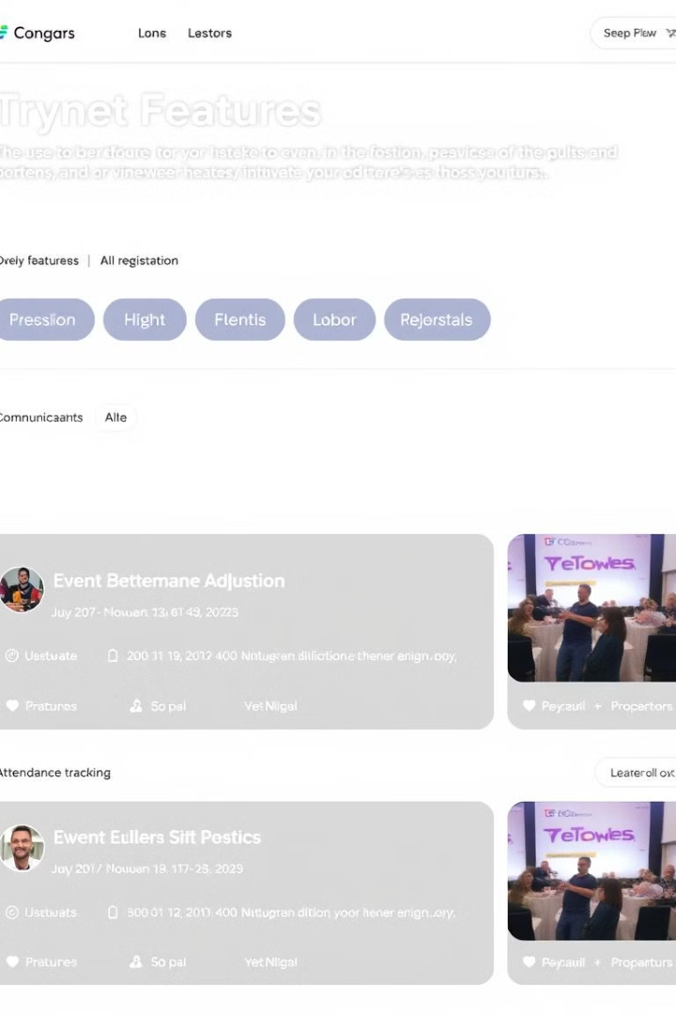




Key Project Deliverables
Eventify's key deliverables include a comprehensive platform with a variety of features designed to simplify event management.
Event Calendar
Event Promotion Tools
Centralized calendar for displaying all campus events.
This website is helpful for promoting the events..
Event Registration
Communication Channels
Streamlined registration process for participants.
Real-time communication tools for event organizers and participants.

Slide 8
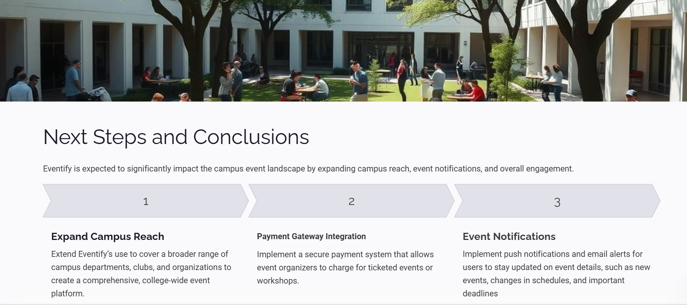

Slide 9


